Slide 1
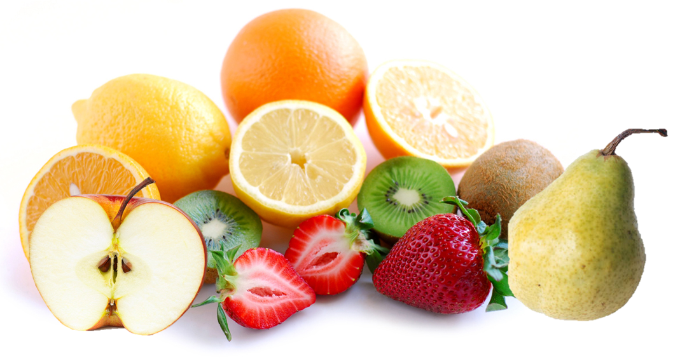

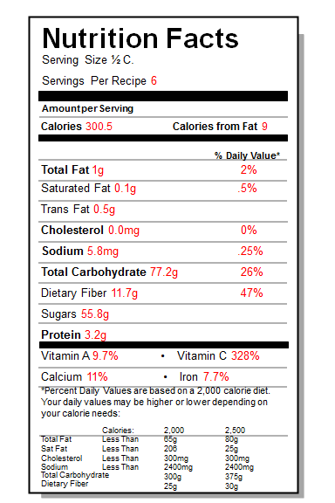
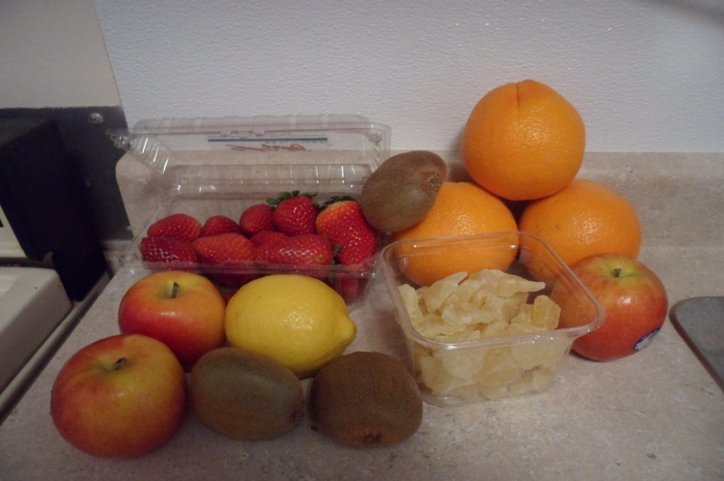

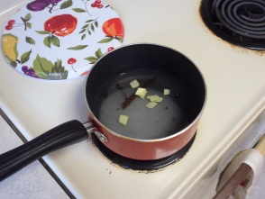
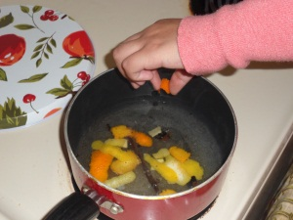
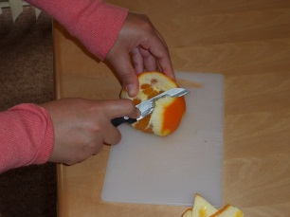
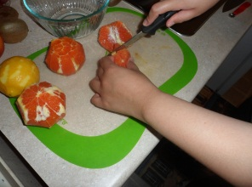
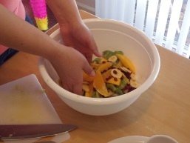
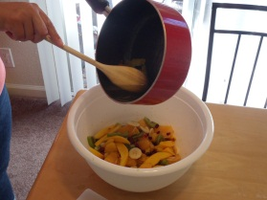
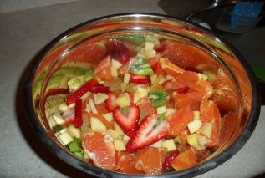

Winter Fruit Salad
Number of Servings: 6
Serving Size: ½ C.
Prep time: 30 minutes
INGREDIENTS:
½ C. sugar
1 Tsp. vanilla extract
1 lemon
5 large navel or blood oranges
4 dried pears, cut into thin-strips
3 apples, peeled, cored and diced
5 kiwis, peeled, halved and sliced
1 basket strawberries, sliced
Important Food Safety Tips:
Wash all fruits thoroughly before cutting into them.
Once prepared, the salad should be kept chilled at all times; temperature should never be above 41° F
Place any leftovers inside a tight sealed container and store in the refrigerator.
Wash, rinse and sanitize all equipment that is used.
Final Cost Comparison
1. Combine the sugar, 2 cups of water, the ginger and vanilla seeds and pod in a saucepan.
2. Remove wide strips of zest from the lemon and 1 orange, add to the saucepan and bring to a boil over medium-high heat. Reduce the heat and simmer 5 minutes. Refrigerate until cold.
Dole Fruit Cocktail | $0.80
Winter Fruit Salad | $2.36
Total Loss Per Serving | $-1.56
Recipe Cost per Person
3.Peel the remaining oranges with a paring knife, cutting along the natural curve of the fruit.
4. Hold an orange over a large bowl and cut along both sides of each membrane to free the segments, letting them fall into the bowl. Repeat with the remaining oranges.
5. Add the apples, strawberries, kiwis and dried pears and gently toss.
Ingredient | Cost
Sugar | $0.09
Vanilla extract | $0.11
Lemon | $0.08
Oranges | $0.28
Apples | $0.32
Kiwis | $0.37
Dried Pears | $0.55
Strawberries | $0.56
Total | $2.36
6. Strain the syrup and pour over the fruit . Chill overnight.
7. Spoon the fruit and syrup into the bowls and enjoy!
Created By: Cynthia Garcia and Callie Martin, Undergraduate Students, Nutrition and Food Sciences (NFSC), CSU Chico, NFSC 431 (Foodservice Production and Equipment Systems) Course, 2012

