Slide 1

Esplanade Resort
Sexual Harassment Scenarios and Prevention In-service
By: Callie Martin Foodservice Manager and Nicole Moore Foodservice Manager

Slide 2
Table of Contents
Define Laws
Myth vs. Reality
Types of conduct
Sexual Harassment vs. Discrimination
Employer Responsibilities
Workplace Behavior
Prevention
Practical Examples

Slide 3
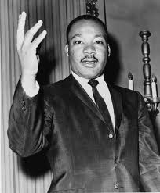


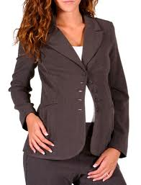
Definitions of unlawful sexual harassment under California state and federal law
Title VII of the Civil Rights Act of 1964
Illegal to discriminate against someone on the basis of their:
Race
Color
Religion
national origin
sex
The Pregnancy Discriminations Act (Under Title VII)
Illegal to discriminate against a woman because of:
Pregnancy
Childbirth
medical condition related to pregnancy or childbirth
Notes:
This law makes it illegal to discriminate against someone on the basis of race, color, religion, national origin, or sex. The law also makes it illegal to retaliate against a person because the person complained about discrimination, filed a charge of discrimination, or participated in an employment discrimination investigation or lawsuit. The law also requires that employers reasonably accommodate applicants' and employees' sincerely held religious practices, unless doing so would impose an undue hardship on the operation of the employer's business.
Pregnancy Discrimination Act This law amended Title VII to make it illegal to discriminate against a woman because of pregnancy, childbirth, or a medical condition related to pregnancy or childbirth.

Slide 4
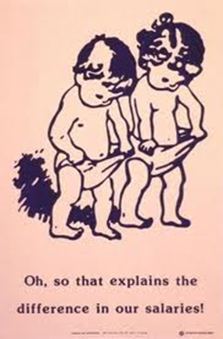
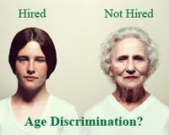
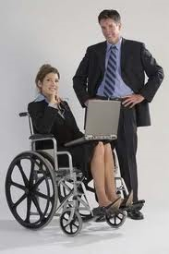
Definitions of Unlawful Sexual Harassment Under Federal Law
The Equal Pay Act of 1963 (EPA)
The Age Discrimination in
Employment Act of 1967 (ADEA)
Title 1 of the Americans with
Disabilities Act of 1990 (ADA)
Notes:
Equal Pay:This law makes it illegal to pay different wages to men and women if they perform equal work in the same workplace.
Age Discrimination: This law protects people who are 40 or older from discrimination because of age.
Americans with Disabilities Act: This law makes it illegal to discriminate against a qualified person with a disability in the private sector and in state and local governments. The law also requires that employers reasonably accommodate the known physical or mental limitations of an otherwise qualified individual with a disability who is an applicant or employee, unless doing so would impose an undue hardship on the operation of the employer's business.
All of the law also makes it illegal to retaliate against a person because the person complained about discrimination, filed a charge of discrimination, or participated in an employment discrimination investigation or lawsuit.

Slide 5
Myth vs. Reality
Less than 1% of complaints from women of sexual harassment are false. In fact, many victims never report harassment at all.
Women who are sexually harassed bring it on themselves by the way they dress or act.
Sexual harassment is rare.
If an employee asks another employee for a date, this could be grounds for sexual harassment charges.
      In the United States, 1 in 5 women and 1 in 71 men report that they have experienced an attempted or completed rape in their lifetime.
Notes:
Studies have shown that sexual harassment victims vary in physical appearance, type of dress, age and behavior.
Sexual harassment touches the lives of 40 – 60 percent of working women and similar proportions of female students in colleges and universities. While not as common, men can also be victims of sexual harassment.
As long as there is no coercion, asking another employee for a date should not constitute harassment. However, continued asking or retaliation for a negative response can be considered harassment. When a person makes it clear sexual content in the relationship is not welcome, his or her wishes must be respected.

Slide 6
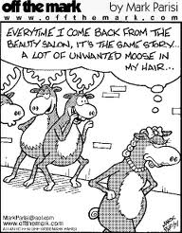
The types of conduct that constitute sexual harassment
Verbal or Written
Physical
Nonverbal
Visual

Slide 7
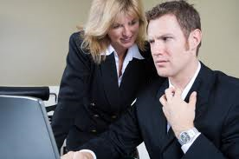
Verbal or Written
Comments about clothing, personal behavior, or a person’s body
Sexual or sex-based jokes
Requesting sexual favors or repeatedly asking a person out
Sexual suggestions
Telling rumors about a person’s personal or sexual life
Threatening a person

Slide 8

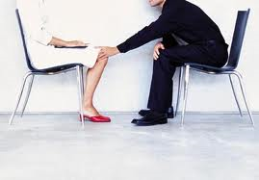
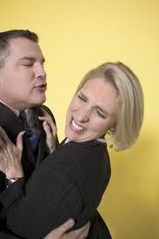
Physical
Assault (Attack)
Blocking movement
Inappropriate touching of
a person or a person’s clothing
Kissing
Hugging
Patting
Stroking

Slide 9
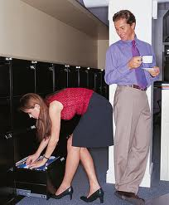
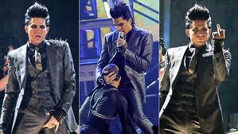
Nonverbal
Looking up and down a
person’s body
Derogatory (offensive)
gestures or facial expressions of sexual nature; following a person

Slide 10

Visual
Posters, drawings, pictures, screensavers of sexual nature
Sending, forwarding or soliciting sexually suggestive letters, notes, emails, text messages or images

Slide 11
How to identify the differences between sexual harassment and discrimination
Sexual Harassment
Discrimination
Actions of sexual content directed toward an individual
When sexuality is used to degrade another person
Consistently asking for a date
Unwanted, unwelcomed, and repeated behavior of a sexual nature
Involves some type of interaction between the sexes that suggest hints of sexuality, sex roles, gender stereotypes, or sexual behavior
Making a distinction in favor of or against, a person based on the group to which that person belongs
Notes:
Sex discrimination can be placed under the heading of sexual harassment

Slide 12

Employer Responsibilities to Employee
Civil Rights Act of 1964
Title VII
  Take reasonable care to prevent sexual harassment.
  Take reasonable care to promptly correct sexual harassment that has occurred.
Notes:
As supervisors, we are here to emphasize to all of you that sexual harassment will not be tolerated and to advise you on what kinds of behaviors are illegal. We ask that you report all offensive conduct so that we can take immediate corrective action.

Slide 13

Workplace behavior
Acceptable
Uncomfortable
Inappropriate
Unacceptable

Slide 14

Correct workplace behavior
Acceptable
Notes:
Acceptable behavior includes counseling on performance or communications, normal social interactions, polite compliments, and touching which could not reasonably be perceived in a sexual or threatening way.

Slide 15
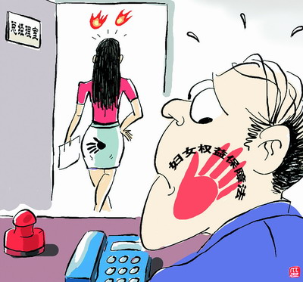
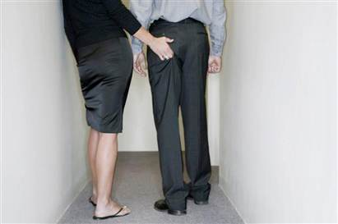
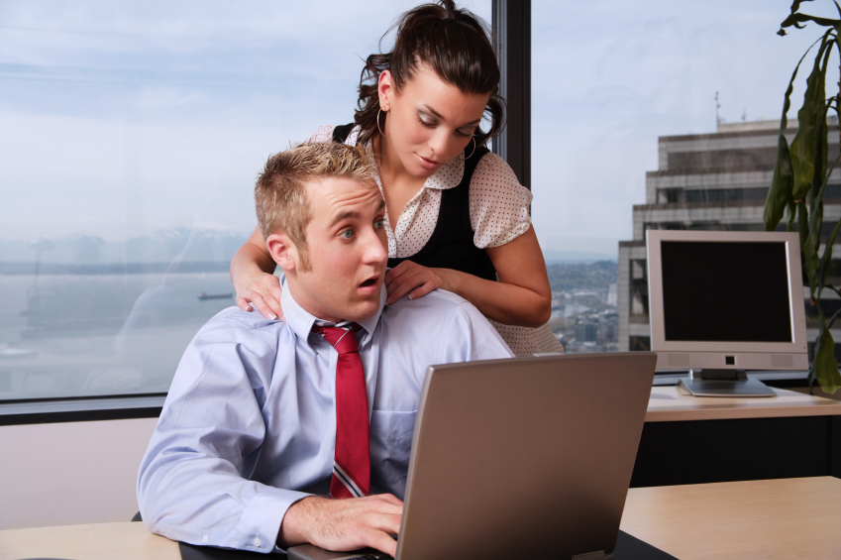
Incorrect Workplace Behavior
Uncomfortable
Inappropriate
Unacceptable
Notes:
- Uncomfortable behavior is that which creates discomfort in the recipient or the observer, but which appears to be acceptable to the majority or leaders of the group. Behaviors such as provocative comments on dress, or hugs or kisses routinely given in greeting may also fall into this category.
Inappropriate behavior is behavior that most people perceive to be improper in the workplace. This includes sexual jokes, boasting of extraordinary sexual abilities, violations of personal space. This behavior is situational and whether or not is is classified as sexual harassment depends on the individuals involved as well as those who witnessed it. If inappropriate behavior spreads throughout the workplace it can create a hostile environment and move into the unacceptable range.
Unacceptable behavior includes asking for sexual favors in return for promotion, assignments, travel, or training; making supervisory decisions based on rave of gender; sending “hate” mail; and of course, criminal offenses such as assault or rape.

Slide 16
How to prevent sexual harassment
It is helpful for the victim to directly inform the harasser that the conduct is unwelcome and must stop.
Be direct and specific about what is offensive to you. If you are not comfortable with a personal confrontation, write a letter that describes the behavior and makes it clear that you want it to stop. Keep a copy, have someone witness it. Describe exactly what happened. Document the alleged harassment: include dates of incidents, time of day, location, names of the persons involved, and possible witnesses.
The victim should use the companies employer complaint mechanism.
Notes:
Employees preventing sexual harassment in the workplace

Slide 17
Practical Examples
Case Scenario 1
Bob and Olga, catering associates, travel together on a week-long trip to a convention. They are currently In a taxi ride from the airport to the hotel.
While Olga finds Bob’s behavior offensive and unwelcome, the regulations regarding sexual harassment in the work place are not relevant, since Bob and Olga were not at their usual workplace when the incident happened.
True or False?
Notes:
Tim snuggles up to Olga and tries to hold her hand. Olga strongly objects, and Tim backs off.

Slide 18
Practical Examples
Case Scenario 2
This is Jim and his co-worker Maria whom are both sous chefs at a restaurant in town.
Jim’s behavior does not constitute sexual harassment, because sexual harassment may only occur between a male boss and a female subordinate.
True or False?
Notes:
Jim is going to persistantly ask Maria out to dinner

Slide 19
Practical Examples
Case Scenario 3
This is Sierra who has just returned from maternity leave.
The boss’s behavior constitutes as sexual harassment?
True or false?
Notes:
and needs to leave work promptly at 5:00 to pick up her child at child care.

Slide 20
Remember…
It is unlawful to harass a person (an applicant or employee) because of that person’s sex. Harassment can include “sexual harassment” or unwelcome sexual advances, requests for sexual favors, and other verbal or physical harassment of a sexual nature.
Harassment does not have to be of a sexual nature, however, and can include offensive remarks about a person’s sex. For example, it is illegal to harass a woman by making offensive comments about women in general.
Both victim and the harasser can be either a woman or a man, and the victim and harasser can be the same sex.

Slide 21
…Remember.
Although the law doesn’t prohibit simple teasing, offhand comments, or isolated incidents that are not very serious, harassment is illegal when it is so frequent or severe that it creates a hostile or offensive work environment or when it results in an adverse employment decision (such as the victim being fired or demoted).
The harasser can be the victim's supervisor, a supervisor in another area, a co-worker, or someone who is not an employee of the employer, such as a client or customer.

Slide 22

If you feel you have been harassed
Remember sexual harassment will not go away by itself and you are not to blame.
Strategies:
Say no to the harasser.
Immediately inform a manager and a designated EO you can call 1-800-669-4000
Do what you need to do to keep yourself safe.
  Write a letter that describes the behavior and makes it clear that you want it to stop. Keep a copy, have someone witness it, or send it certified mail.
  Describe exactly what happened. Include dates of incidents, time of day, location, names of the persons involved and possible witnesses.

Slide 23
FYI
  April is Sexual Assault Awareness Month
    Visit this link for more information http://www.cdc.gov/Features/SexualViolence/
      If you are, or know someone who is, the victim of sexual violence, contact the Rape, Abuse, and Incest National Network (RAINN) hotline at 1-800-656-HOPE or contact your local emergency services at 9-1-1.

Slide 24
Works CIted
http://www.eeoc.gov/laws/statutes/index.cfm
http://www.eeoc.gov/facts/fs-sex.html
http://www.fcc.gov/encyclopedia/understanding-workplace-harassment-fcc-staff
http://eeo.gsfc.nasa.gov/docs/Sex_Har_Web.pdf
http://www.stopvaw.org/uploads/case.pdf

