Slide 1
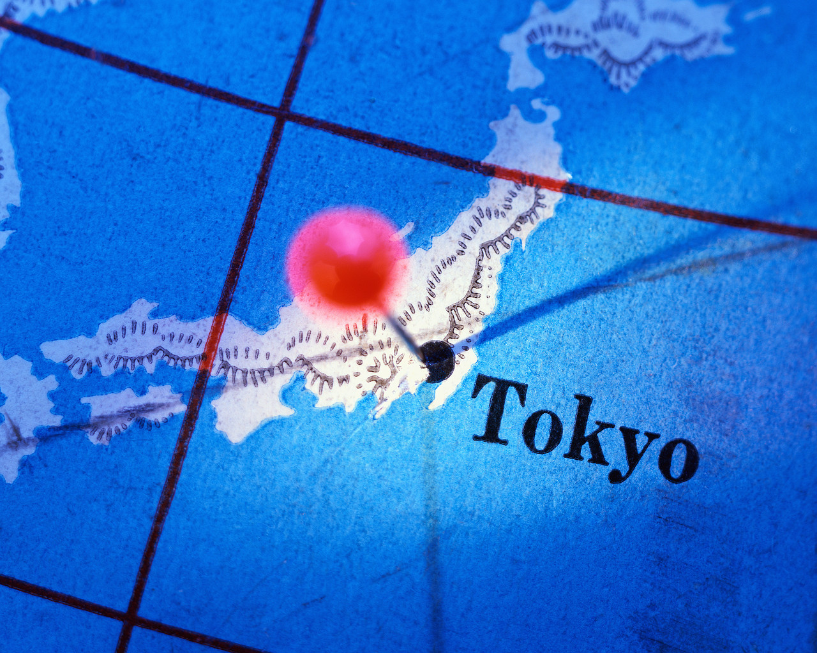
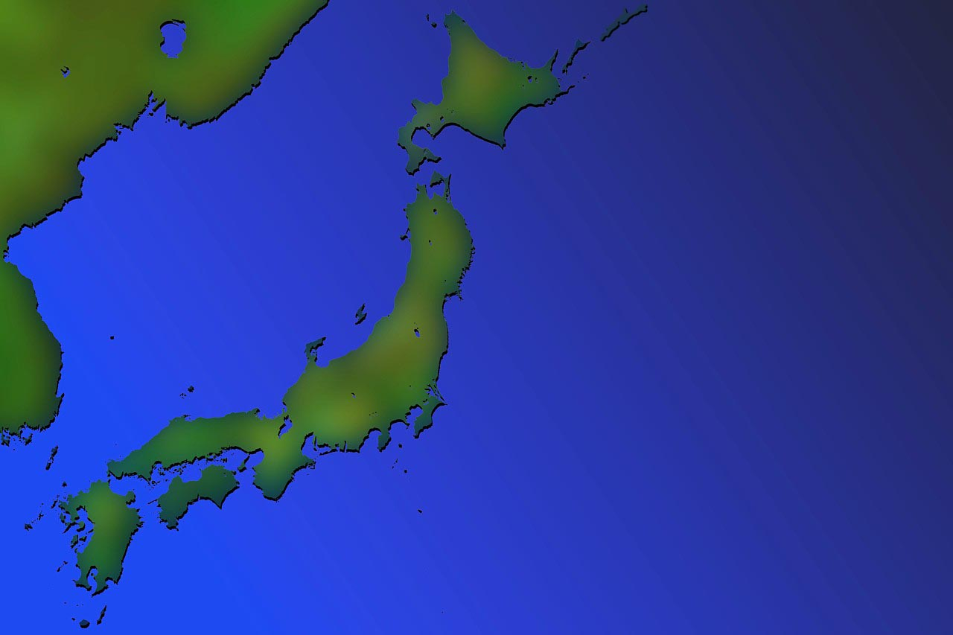

Japanese History and Politics
漆文化

Slide 2
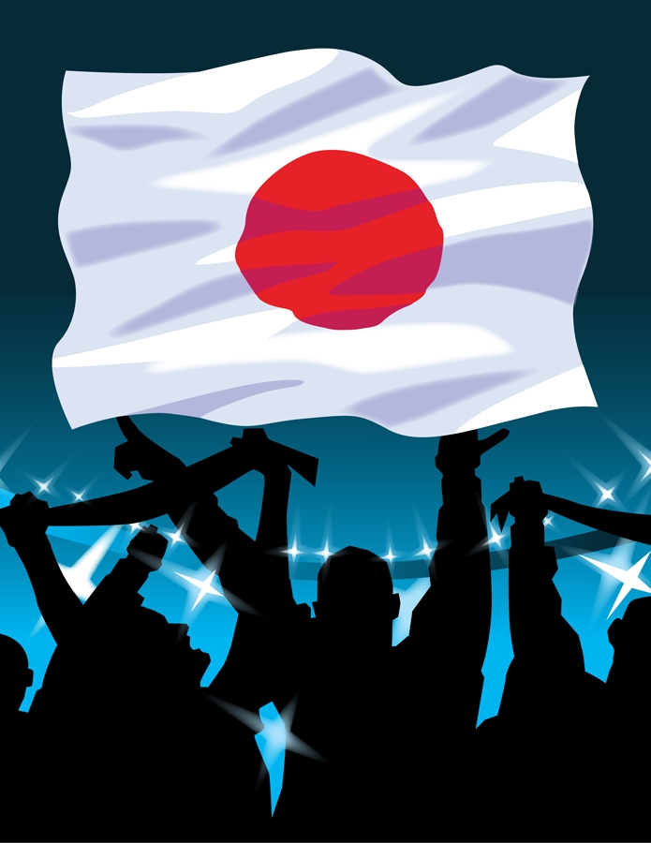
Japanese History 漆衣類
300 BC-300 The introduction of rice agriculture (probably from Korea and China) begins the development of a social hierarchy and hundreds of small countries that started to unify into larger countries.
538 Introduction of Buddhism from China
1192 Minamoto Yoritomo is appointed shogun (military commander) and establishes the Kamakura government (military government).
1542 Portuguese introduce firearms and Christianity to Japan.
1592-1600 Toyotomi Hideyoshi takes over and confiscates the weapons of farmers and religious institutions in the "Sword Hunt". 1592-98 Unsuccessful invasion of Korea. 1600 Tokugawa Ieyasu defeats Toyotomi in the battle of Sekigahara.
References: http://www.japan-guide.com/e/e641.html

Slide 3
History cont.
漆食物
1603 Leyasu is appointed shogun and establishes the Tokugawa government in Edo (Tokyo). This government focused on the samurai being the warriors of pre modern Japan that made up the ruling military class that eventually became the highest ranking social caste.
Samurai employed a range of weapons, but their main weapon and symbol was the sword. Samurai were supposed to lead their lives according to the ethic code of bushido ("the way of the warrior"). Strongly Confucian in nature, bushido stressed concepts such as loyalty to one's master, self discipline and respectful, ethical behavior
References: http://www.japan-guide.com/e/e641.html

Slide 4
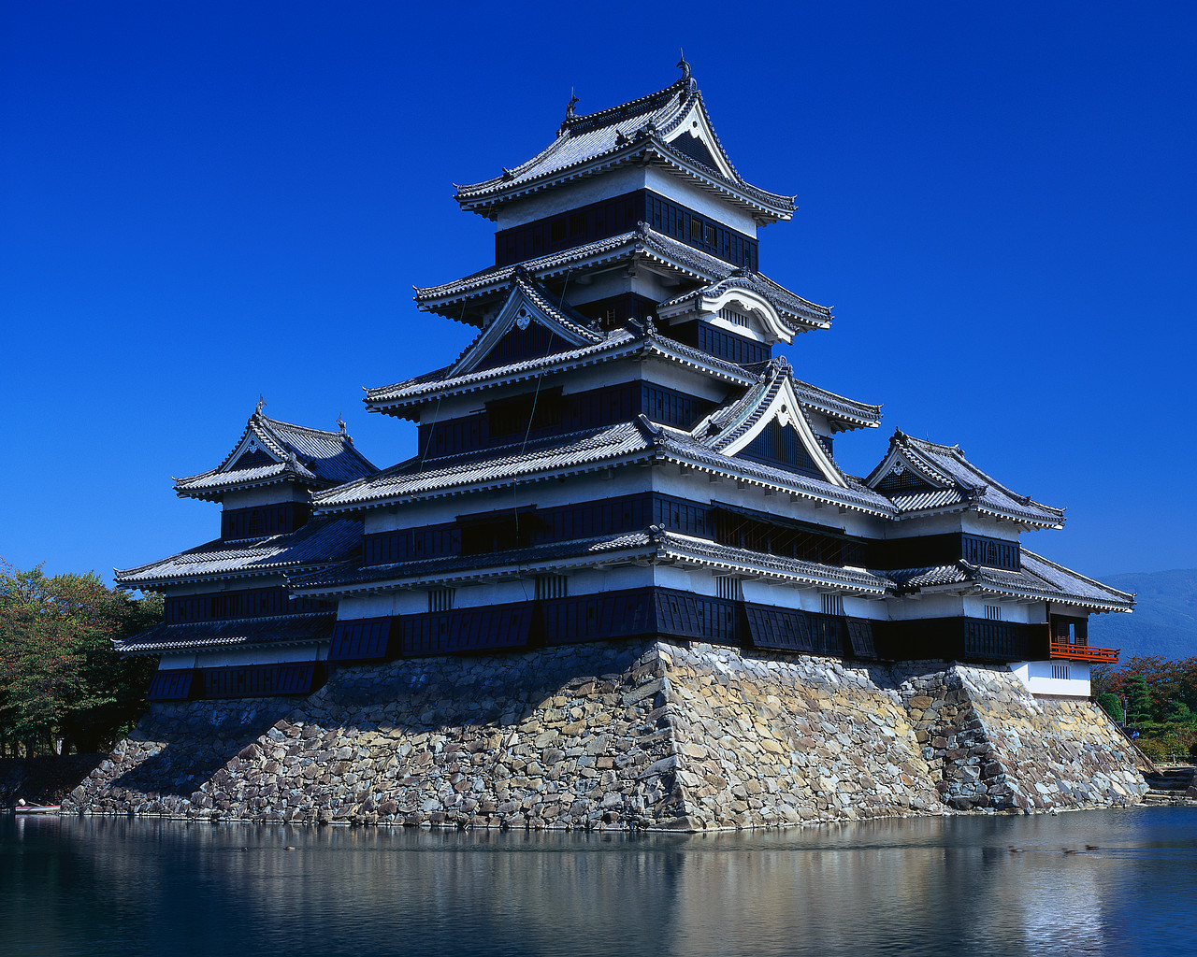
History cont. 漆の結婚
1614 Ieyasu intensifies persecution of Christianity. 1615 The Toyotomi clan is destroyed after Ieyasu captures Osaka Castle. 1639 Almost complete isolation of Japan from the rest of the world. A little over 200 hundreds years later in 1854 Commodore Matthew Perry (in the US Navy) forces the Japanese government to open a limited number of ports for trade of coal.
1868 Meiji restoration. Basically a new emperor overthrew the samurai. As a result, the importance of martial skills declined, and many samurai became bureaucrats, teachers or artists. Japan's feudal era eventually came to an end in 1868, and the samurai class was abolished a few years afterwards. 1889 The Meiji Constitution is propagated (With the Meiji Restoration of 1868, the Tokugawa Shogunate was overthrown, and Emperor Meiji became the head of state. Under the new Meiji constitution, the Emperor held sovereign power, and his political and military power was theoretically close to absolute.)1894-95 Sino-Japanese War. (war between China and Japan over Korea) 1904-05 Russo-Japanese War.
1910 Occupation of Korea. 1912 Death of emperor Meiji.
Reference: http://www.japan-guide.com/e/e641.html

Slide 5
History Cont.漆の宗教
1914-18 Japan joins allied forces in WW1. 1923 The Great Kanto Earthquake devastates Tokyo and Yokohama. 1937 Second Sino-Japanese War starts when Japan attacked China which turned into WWII when Japan attacked Pearl Harbor in 1941 Pacific War starts. 1945 Japan surrenders after two atomic bombs are dropped over Hiroshima and Nagasaki. After World War II had ended, Japan was devastated. All the large cities (with the exception of kyoto), the industries and the transportation networks were severely damaged. A severe shortage of food continued for several years. The occupation of Japan by the Allied Powers started in August 1945 and ended in April 1952. General MacArthur was its first Supreme Commander. The whole operation was mainly carried out by the United States. Japan basically lost all the territory acquired after 1894. In addition, the Kurile islands were occupied by the Soviet Union, and the Ryukyu Islands, including Okinowa, were controlled by the USA.
References: http://www.japan-guide.com/e/e641.html

Slide 6
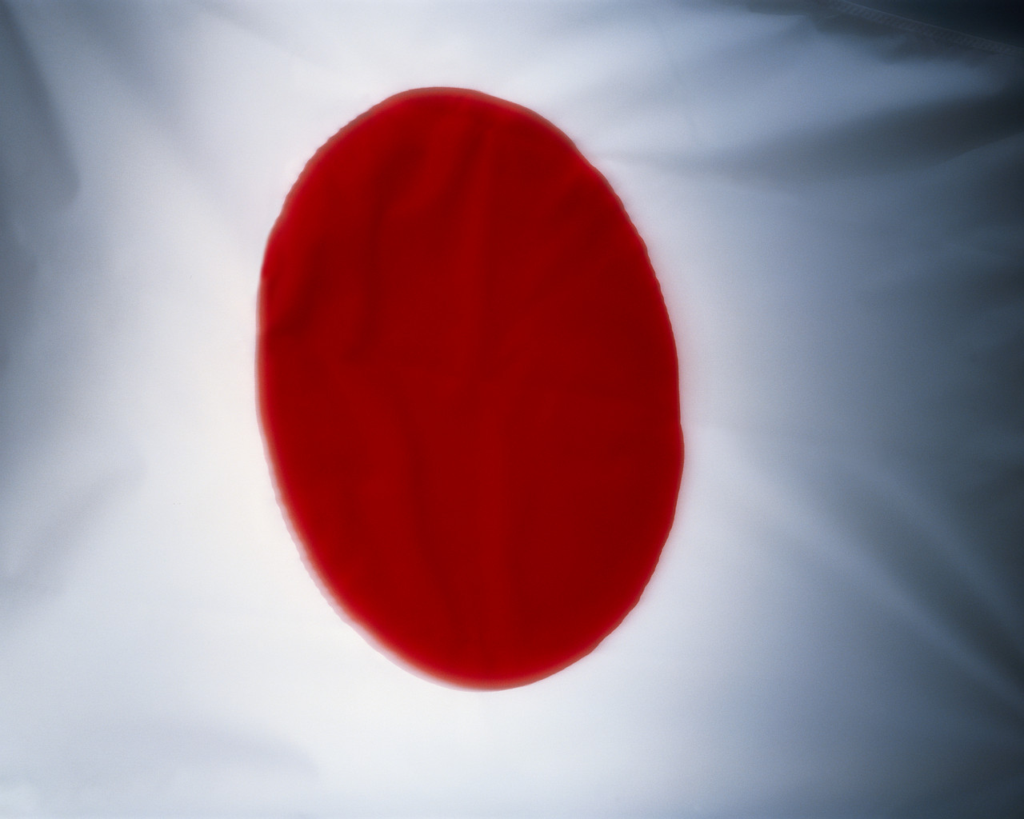
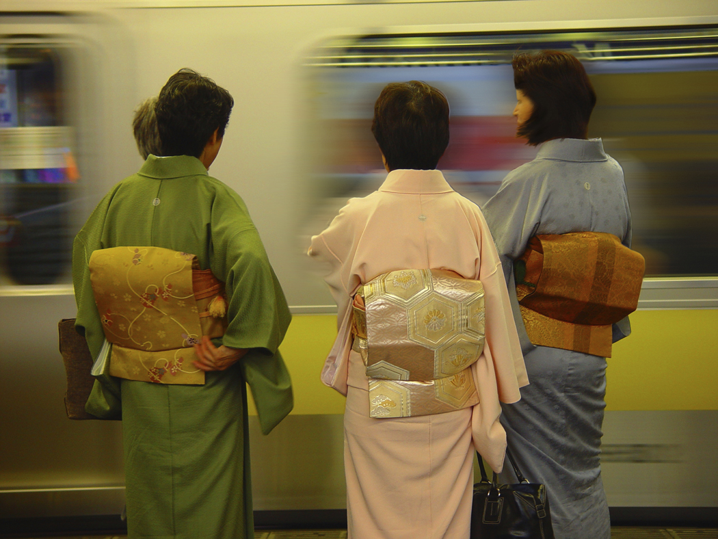
History cont. 漆の宗教
1947 The new constitutin went into effect. With the new constitution the emporer lost all political and military power, and was solely made the symbol of the state. Human rights were guaranteed. Japan was also forbidden to ever lead a war again or to maintain an army.
1952 The Allied Occupation of Japan ends with the effect of the peace treaty
1956 Japan becomes member of the UN. 1960 renewal of the US-Japan Security Treaty.
1972 Normalization of relations to China. Okinawa was returned to Japan from USA 1973 Oil crisis. The oil crisis shocked the Japanese economy which was heavily depended on oil. The reaction was a shift to high technology industries.
1995 The Great Hanshin Earthquake hits Kobe. Sarin Gas attack in the Tokyo subway by AUM sect.
2011 Great East Japan Earthquake
References: http://www.japan-guide.com/e/e641.html

Slide 7
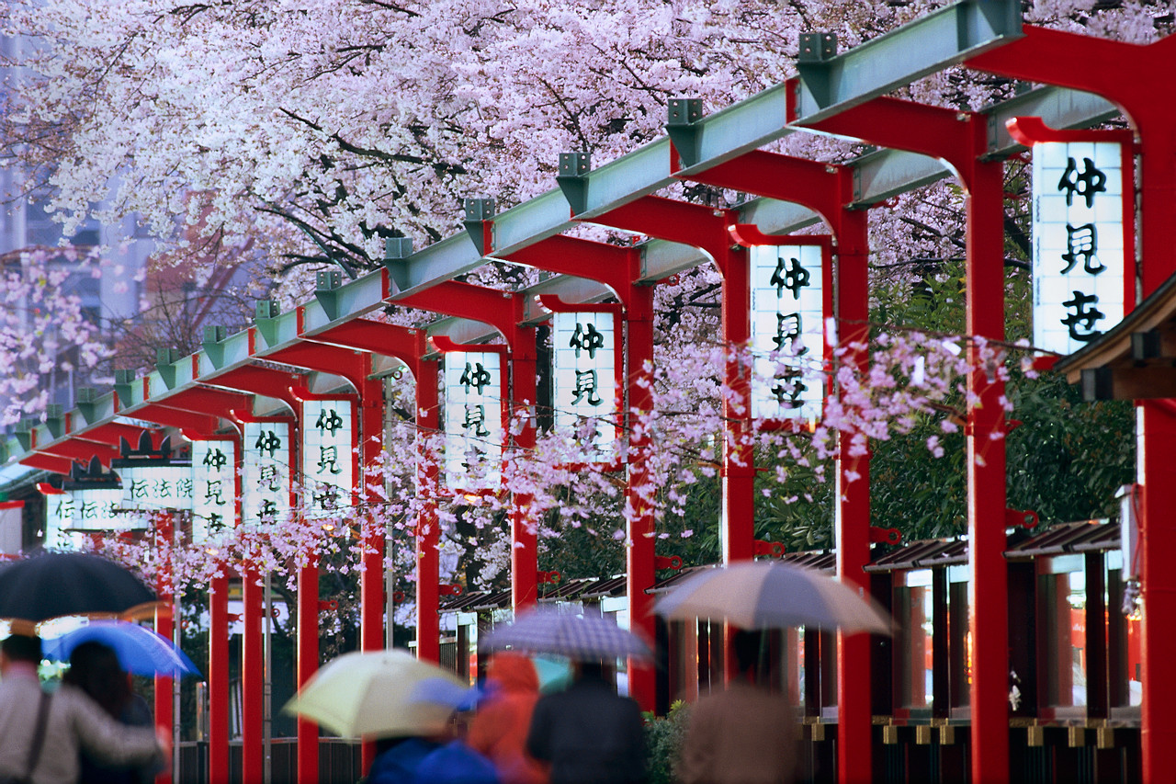
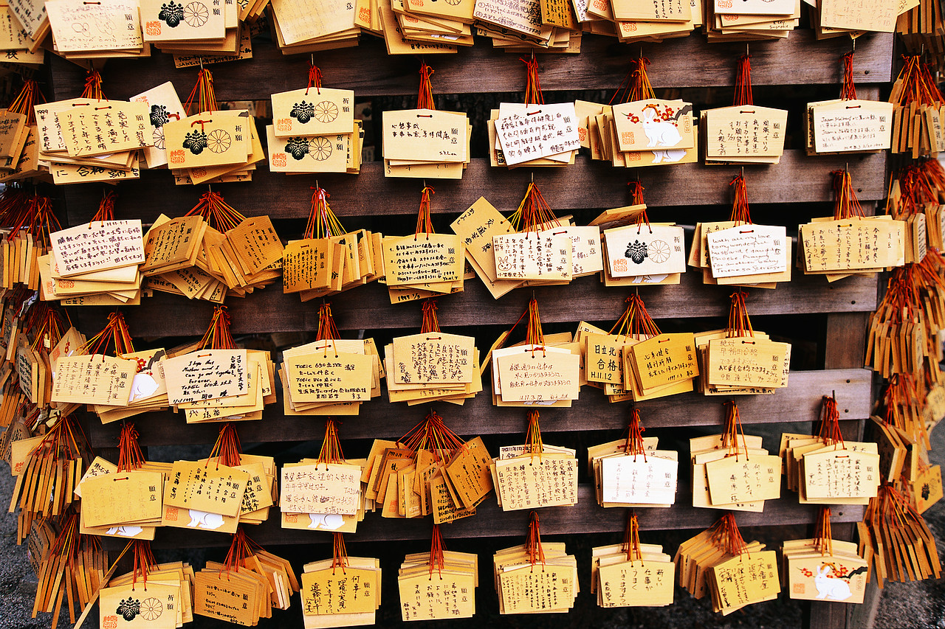
Politics 漆の宗教
Government
The current Japanese constitution went into effect on May 3, 1947.
Legislature: The Japanese parliament is called the Diet. It consists of the House of Representatives and the House of Councillors The members of the Diet are elected by the Japanese people.
Executive: The cabinet is headed by the Prime Minister. The cabinet further consists of the ministers which are appointed by the prime minister and are usually members of the Diet. The prime minister is elected by the Diet.
Judiciary: The highest court is the Supreme Court. Other courts are district courts, high courts, family courts, and summary courts. Judges are appointed by the cabinet.
Elections: The minimum voting age is 20 years. Women received the right to vote in the new constitution.
Reference: http://www.japan-guide.com/e/e2136.html

Slide 8
Politics
漆のテクノロジー
Self Defense Force
The postwar constitution prohibits Japan to maintain military forces and to lead war for settling international disputes.
Despite the anti-war clause, Japan has a Self Defense Force (SDF) which is divided into three branches:
Ground Self Defense Force
Maritime Self Defense Force
Air Self Defense Force
The Self Defense Force's purpose is to preserve peace, public order and Japan's independence and safety. Military service is voluntary.
References: http://www.japan-guide.com/e/e2138.html

Slide 9
Politics 漆の習慣
Emporer
According to mythology, it is a commonly accepted fact that emperors have reigned over Japan for more than 1500 years, and that they have all descended from the same imperial family.
The postwar constitution of 1946 states that the emperor has only a symbolic function. He now mainly participates at ceremonies and diplomatic meetings, but has no effective political power and is only the symbol of the state.
In 1989, Emperor Akihito became Japan's 125th emperor.
Economy
The Japanese economy is one of the third largest in the world. Only the USA and China have a higher GNP. The Japanese currency is the Yen.
Exports: Japan's main export goods are cars, electronic devices and computers. Most important trade partners are China and the USA, followed by South Korea, Taiwan, Hong Kong, Singapore, Thailand and Germany.
Imports: Japan has a surplus in its export/import balance. The most important import goods are raw materials such as oil, foodstuffs and wood. Major supplier is China, followed by the USA, Australia, Saudia Arabia, South Korea, Indonesia and the United Arab Emirates.
Industries: Manufacturing, construction, distribution, real estate, services, and communication are Japan's major industries today. Agriculture makes up only about two percent of the GNP. Most important agricultural product is rice.
References: http://www.japan-guide.com/e/e644.html
http://www.japan-guide.com/e/e2135.html

