Slide 1

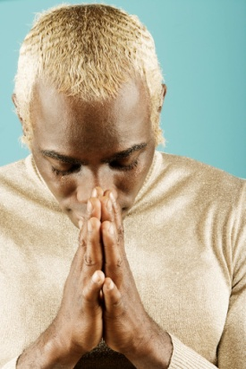
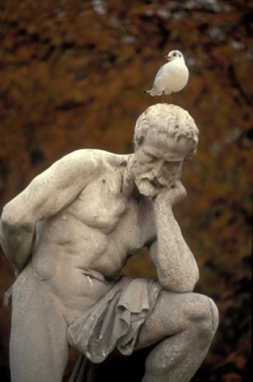

5 things that have taught me to understand and appreciate the society in which we live:
Though shall not judge: You should view people for who they are, not by who you think they are
Think before you speak: Before expressing your thoughts, think about what you are going to say, and how it can affect those around you
Educate: If you hear someone stereotyping a person or a group of people, inform them that not every person is or act like that stereotype
Develop your own opinion: When you learn some new information, do research and educate yourself. What you read and hear, in the news for example, is not always true
Be considerate and respectful: Put yourself in others’ “shoes” and situations both past and present

